Slide 1
Generic Object Recognization
Submitted By
Shrey Gupta-09bce184
Anil kumar-09bce397
Vishal Lahoti-09bce129
Guide
Prof. S.Rajkumar (SCSE)

Slide 2
AGENDA
Objective
Input and Output Data
Application and merits
Overview
Label Me
Object Detection Model
Random 4 filter (explained Laplace of Gaussian)
Random Patch Extraction
Creating Dictionary
Feature computation
Applied Gentleboost classifier
Conclusion
References

Slide 3
Objective
. It is a challenging task to detect objects owing to their variable appearance in and the occlusion in natural scene. In order to remedy the deficiency of the traditional test methods in the object detection.

Slide 4
Continued..
We have a technique which uses a feature vector made by cross convoluting a bank of filters( Laplacian Gaussian, X-derivative and Y-derivative), patches extracted from the object and a segmentation mask. This feature vector is then given as input to a new improved gentleBoost classifier, which enables it to deliver better detection result.

Slide 5
Recognition tools
LabelMe Toolbox
LabelMe Dataset
Matlab

Slide 6
Input and Output data
Input:-
200 Image dataset (courtesy LabelMe, MIT U.S.A).
Laplace of Gaussian
Gentleboost classifier
Output:-
Original annotated Image from the dataset.
Final image with object detected.

Slide 7
Application and merits of object Recognition
1. Android Eyes Object Recognisation
Take a picture of a car. Android Eye will tell you the make and model of the car. Take a picture of a foreign t-shirt label Android Eye will tell you the brand, and where the shirt is from. Take a picture of a tree
1.Object Counting and Monitoring.
2. Face detection.etc

Slide 8
Overview
200 Image dataset.
Applied 4 random filters. Like one of is Laplace of Gaussian(explained later).
Extracted random patches of size 9 to 13.
Created Dictionary of patches.
Calculated segmentation masks.
Computed feature and applied Gentleboost classifier.

Slide 9
LabelME
LabelMe is a project created by the MIT Computer Science and Artificial Intelligence Laboratory (CSAIL) which provides a dataset of digital images with annotations. The dataset is dynamic, free to use, and open to public contribution. The most applicable use of LabelMe is in computer vision research.

Slide 10
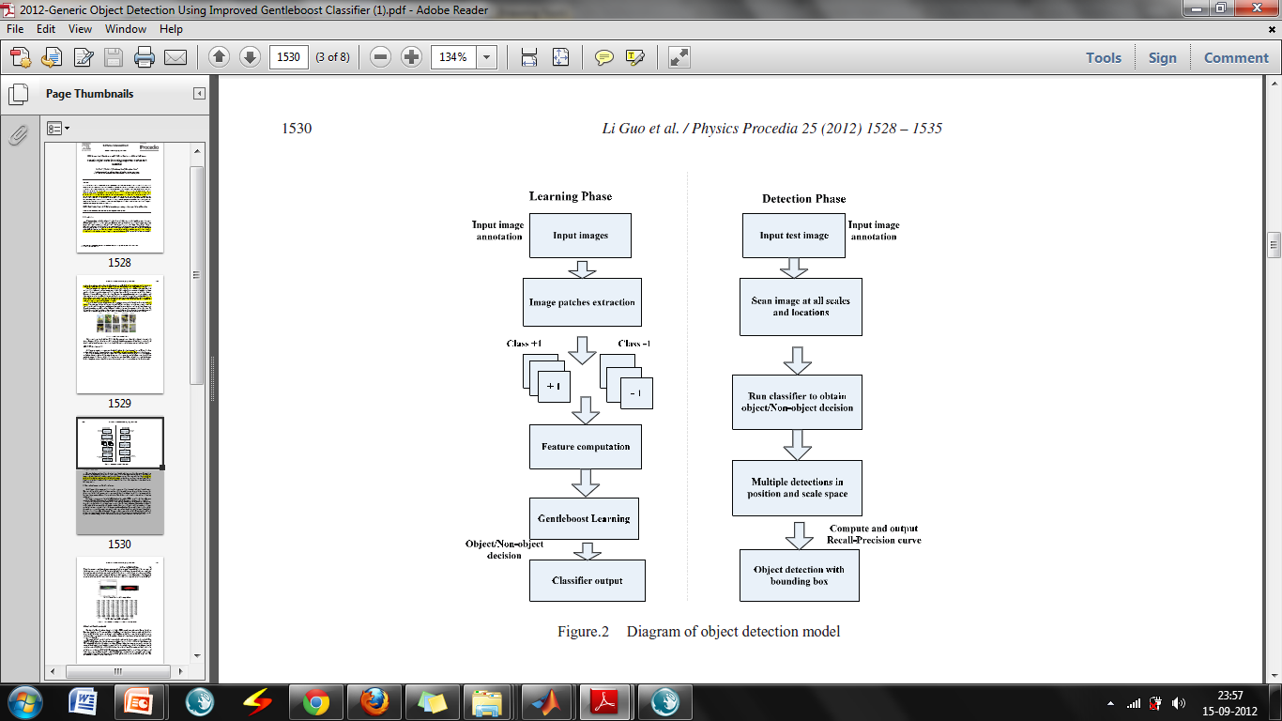
Object Detection Model

Slide 11
Laplace of Gaussian
Laplacian filters are derivative filters used to find areas of rapid change (edges) in images. Since derivative filters are very sensitive to noise, it is common to smooth the image (e.g., using a Gaussian filter) before applying the Laplacian. This two-step process is call the Laplacian of Gaussian (LoG) operation.
The LoG operator takes the second derivative of the image. Where the image is basically uniform, the LoG will give zero. Wherever a change occurs, the LoG will give a positive response on the darker side and a negative response on the lighter side.

Slide 12
Laplace of Gaussian(continued…)
At a sharp edge between two regions, the response will be
zero away from the edge
positive just to one side
negative just to the other side
zero at some point in between on the edge itself

Slide 13
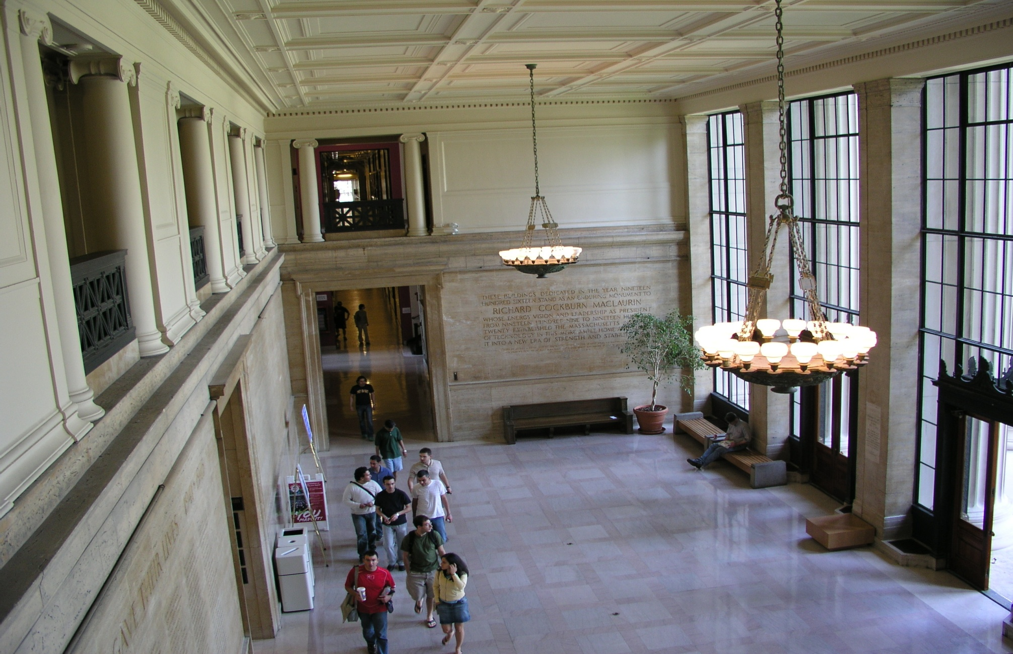
Sample original Image

Slide 14
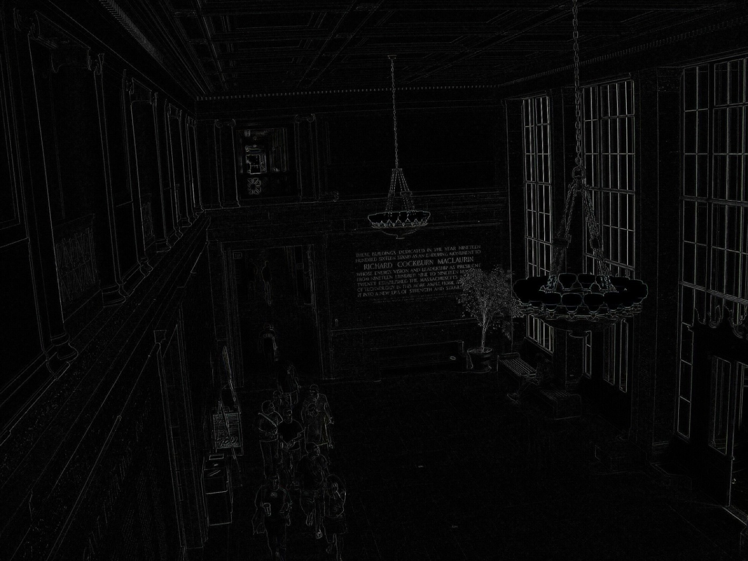
Image after applying LoG

Slide 15
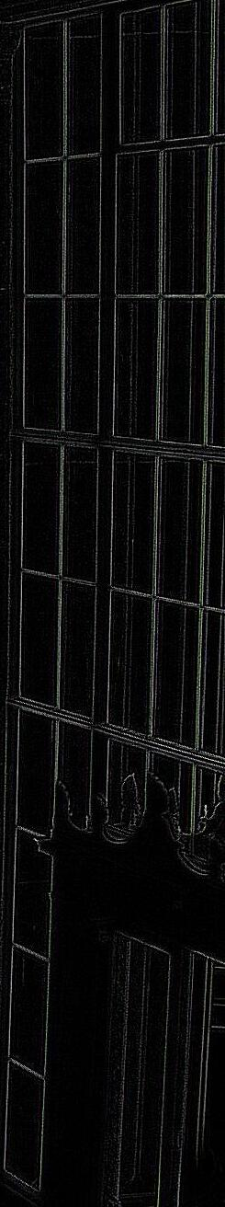
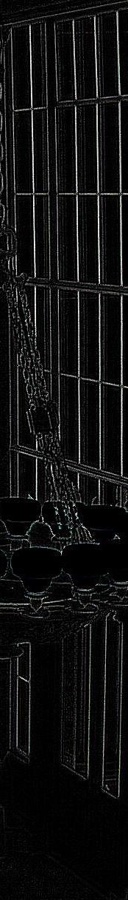

Specified cropped segment(window)
a

Slide 16
Patches..
a

Slide 17
Detection phase
Classifying Training data set as class +1 and -1.
Feature computation.
Applying Classifier . GentleBoost Classifier.

Slide 18
What is classifier??
Classification includes a broad range of decision-theoretic approaches to the identification of images (or parts thereof). All classification algorithms are based on the assumption that the image in question depicts one or more features and that each of these features belongs to one of several distinct and exclusive classes.

Slide 19
classification continued…
The classes may be specified a priori by an analyst (as in supervised classification) or automatically clustered (i.e. as in unsupervised classification) into sets of prototype classes, where the analyst merely specifies the number of desired categories.
In short
The objective of image classification is to automatically categorize all pixels in an image into land cover classes of information themes.

Slide 20
Types of classification
Supervised Classification: The process of using samples of known informational classes(training set) to classify pixels of unknown identity.
Identification and delineation of training areas is key to successful implementation.
Unsupervised classification: In case where there is less information in an area to be classified, only the image characteristics are used as follows.
1.Multiple groups, from randomly sampled data, will be mechanically divided into homogeneous spectral classes using a clustering technique.

Slide 21
Improved GentleBoost classifier.
Popular classifier for object detection includes SVM, neutral network, naïve Bayes classifier, Boosting classifier, etc.
GentleBoost classifier is the iterative combination of classifier to build a strong classifier, which is easy to implement, fast to train and to apply.
Gentle boost classifier has been shown to work well for object detection.

Slide 22
Gentleboost classifier
Boosting provides a simple framework to develop robust object detection algorithms. This set of functions provide a minimal set to build an object detection algorithm.
This demo will first ask for a set of points in 2D to be used a training data (Left button = class +1, right button = class -1). The classifier will only be able to perform simple discrimination tasks as it uses stumps as weak classifiers (i.e., only lines parallel to the axis). If you use weak classifiers to be lines with any orientation, then you will get more interesting boundaries easily. However, stumps are frequently used in object detection as they can be used to do efficient feature selection. This demo will show you the limits of stumps. In object detection, some of these limitations are compensated by using a very large number of features.

Slide 23
Strong classifier sample data
i

Slide 24
Creating classes

Slide 25
Creating classes continued…

Slide 26
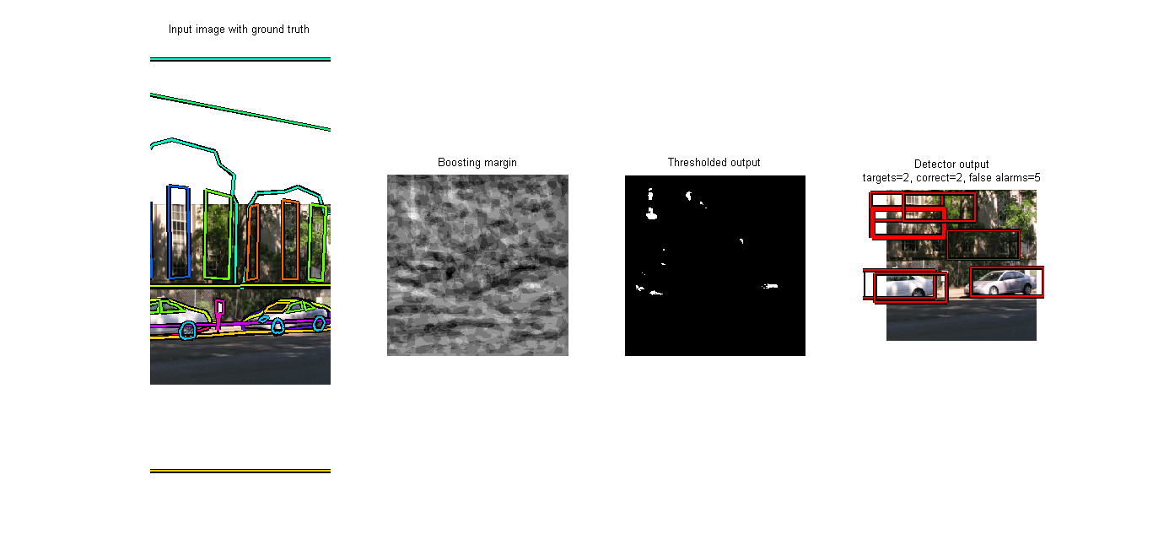
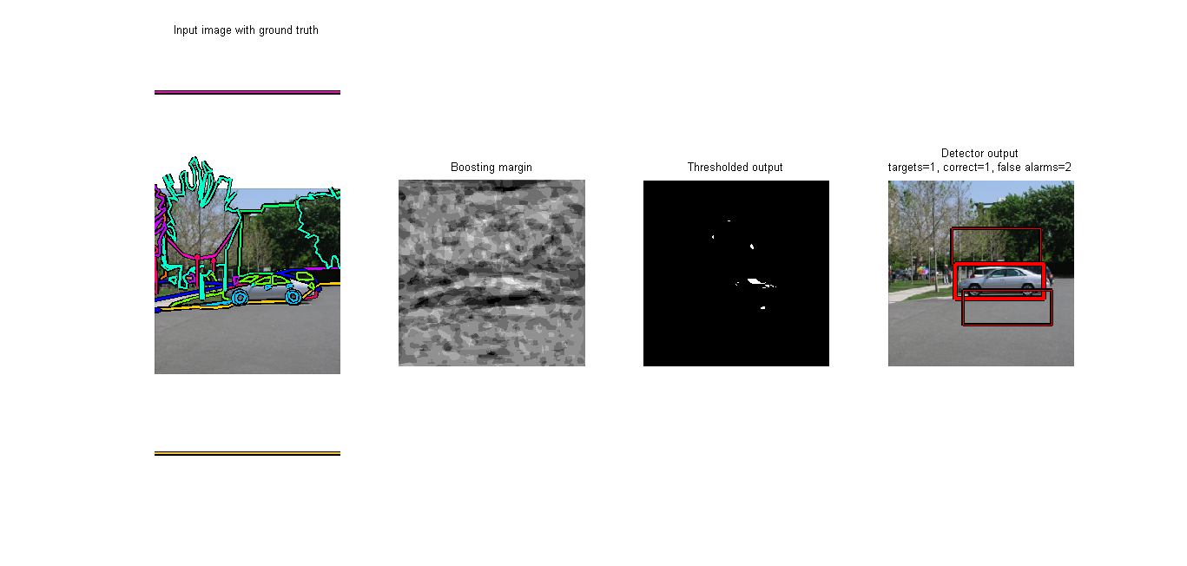
Our desired output

Slide 27
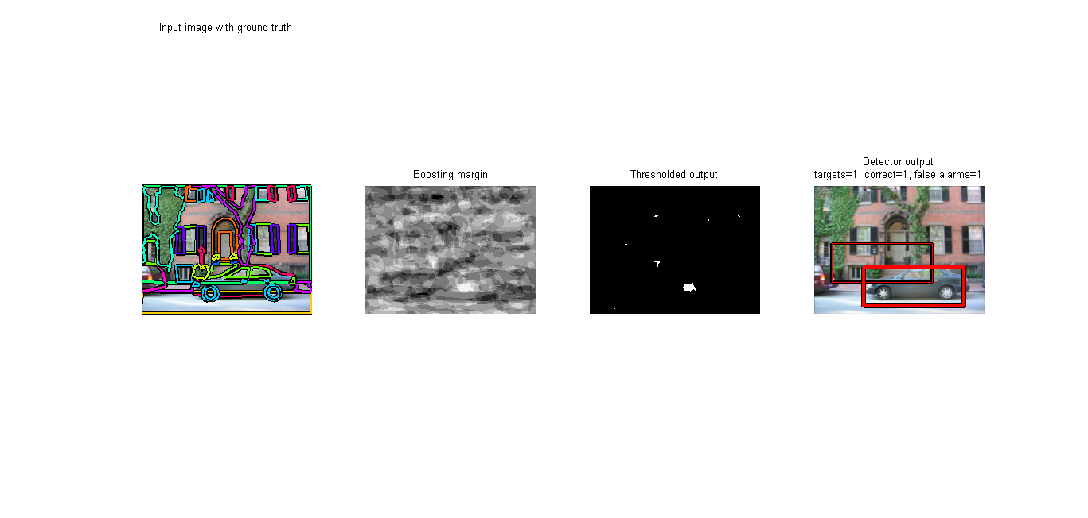
Continued..

Slide 28
Conclusion and future work
Here we have presented a object detection algorithm. Through experimental results, it proved that Generic method for object detection is efficient and accuracy, robust feature encoding for object detection and good performance of classifier for generic object classes detection. Much still needs to be done to further improve this work. We expect that classification accuracy would increase further if we were able to add part-based detector for handling partial occlusions; multiple scale detector based on improved gentle Boost to learn and real-time detection.

Slide 29
Thank you

